Slide 1
Android Training
Adding the Action Bar
http://developer.android.com/training/index.html
师文轩，13920561100，shiwenxuan2003@hotmail.com

Slide 2
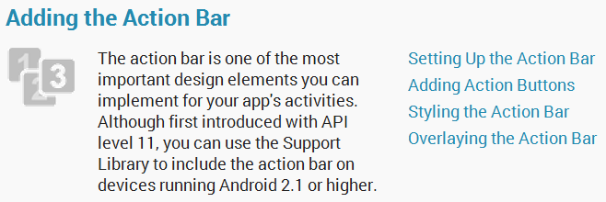
Adding the Action Bar

Slide 3
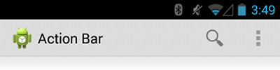
Intro
The action bar is one of the most important design elements you can implement for your app's activities.
It provides several user interface features that make your app immediately familiar to users by offering consistency between other Android apps.

Slide 4
Key functions
A dedicated space for giving your app an identity and indicating the user's location in the app.
Access to important actions in a predictable way (such as Search).
Support for navigation and view switching (with tabs or drop-down lists).

Slide 5
Lessons
Setting Up the Action Bar
Adding Action Buttons
Styling the Action Bar
Overlaying the Action Bar

Slide 6
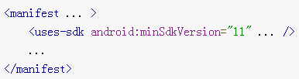
Setting Up the Action Bar
Beginning with Android 3.0 (API level 11), the action bar is included in all activities that use the Theme.Holo theme (or one of its descendants)

Slide 7
Adding Action Buttons
The action bar allows you to add buttons for the most important action items relating to the app's current context.

Slide 8
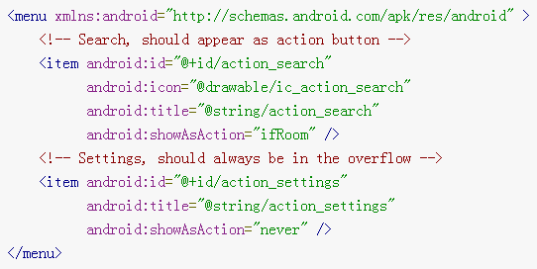
Adding Action Buttons
Specify the Actions in XML
Add an <item> element for each item you want to include in the action bar. For example: res/menu/main_activity_actions.xml

Slide 9
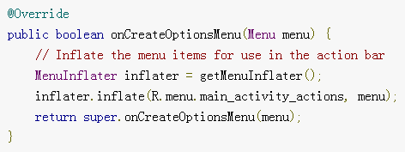
Add the Actions to the Action Bar
To place the menu items into the action bar, implement the onCreateOptionsMenu() callback method in your activity to inflate the menu resource into the given Menu object.

Slide 10
Respond to Action Buttons
When the user presses one of the action buttons or another item in the action overflow, the system calls your activity's onOptionsItemSelected() callback method.

Slide 11
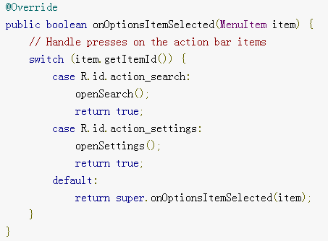

Slide 12

Add Up Button for Low-level Activities
All screens in your app that are not the main entrance to your app (activities that are not the "home" screen) should offer the user a way to navigate to the logical parent screen in the app's hierarchy by pressing the Up button in the action bar.

Slide 13
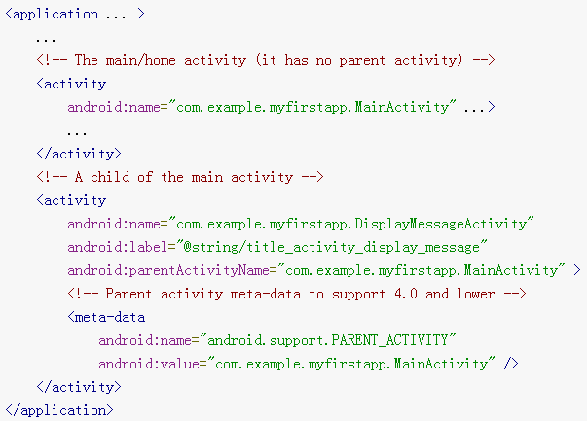
Add Up Button for Low-level Activities
For example, here's how you can declare an activity's parent in the manifest:

Slide 14
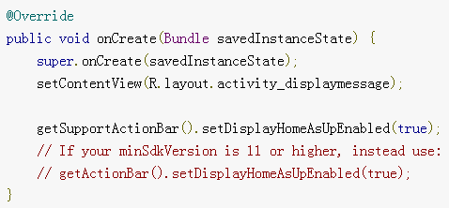
Then enable the app icon as the Up button by calling setDisplayHomeAsUpEnabled():

Slide 15
Styling the Action Bar
Android includes a few built-in activity themes that include "dark" or "light" action bar styles.
You can also extend these themes to further customize the look for your action bar.

Slide 16
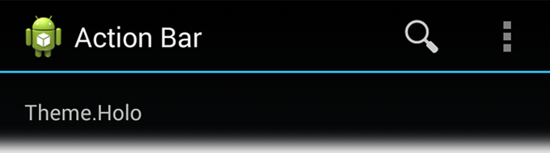
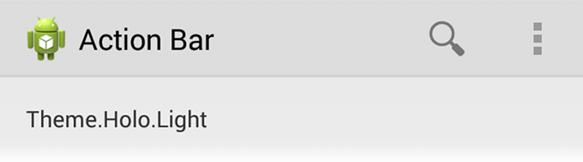
Use an Android Theme
Android includes two baseline activity themes that dictate the color for the action bar:
Theme.Holo for a "dark" theme.
Theme.Holo.Light for a "light" theme.

Slide 17
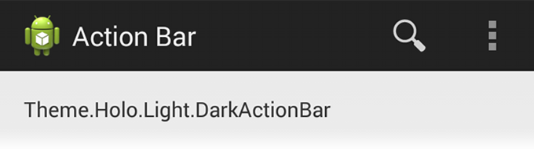
For example:
You can also use a dark action bar while the rest of the activity uses the light color scheme by declaring the Theme.Holo.Light.DarkActionBar theme.

Slide 18
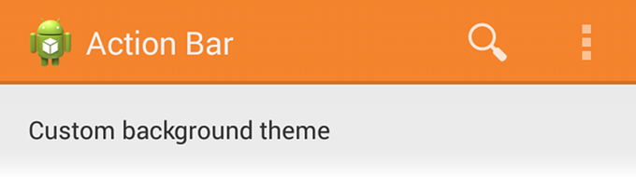
Customize the Background
To change the action bar background, create a custom theme for your activity that overrides the actionBarStyle property.

Slide 19
If your app uses navigation tabs or the split action bar, then you can also specify the background for these bars using the backgroundStacked and backgroundSplit properties, respectively.

Slide 20
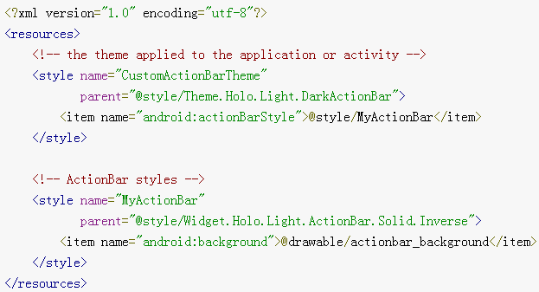
res/values/themes.xml

Slide 21
Then apply your theme to your entire app or individual activities:

Slide 22
Customize the Text Color
To modify the color of text in the action bar, you need to override separate properties for each text element:
Action bar title
Action bar tabs
Action buttons

Slide 23
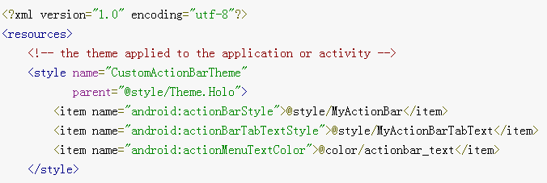
res/values/themes.xml

Slide 24
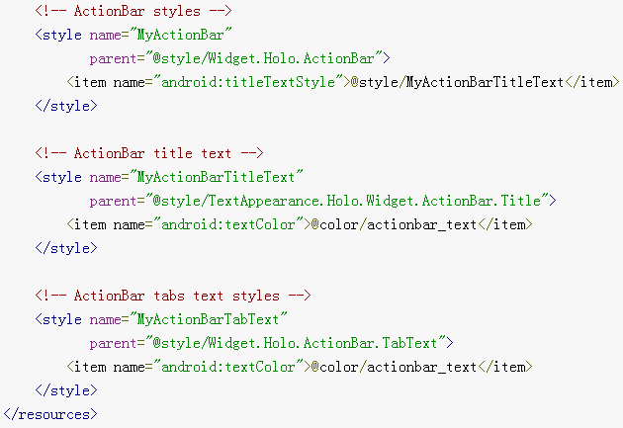

Slide 25
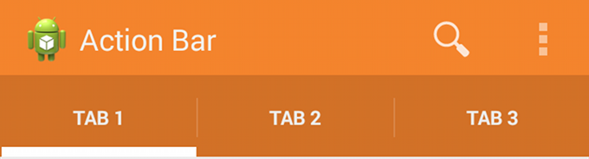
Customize the Tab Indicator
To change the indicator used for the navigation tabs, create an activity theme that overrides the actionBarTabStyle property.

Slide 26
For example, here's a state-list drawable that declares a specific background image for several different states of an action bar tab: res/drawable/actionbar_tab_indicator.xml

Slide 27
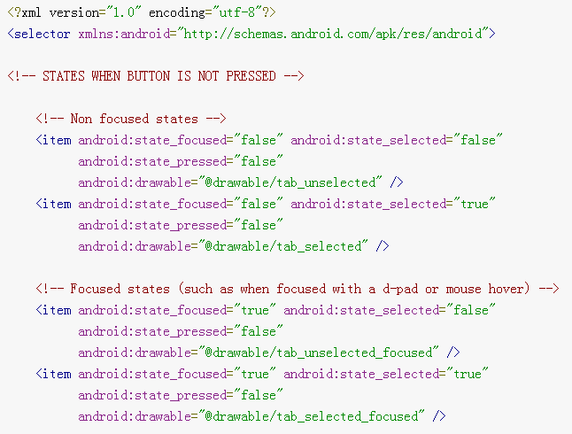

Slide 28
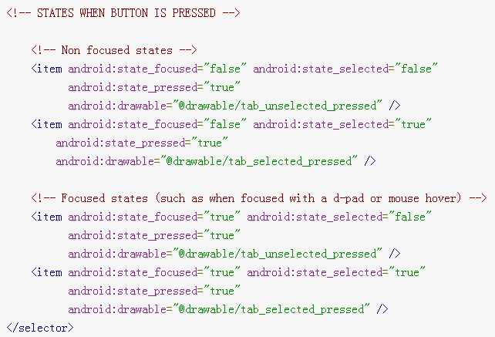

Slide 29
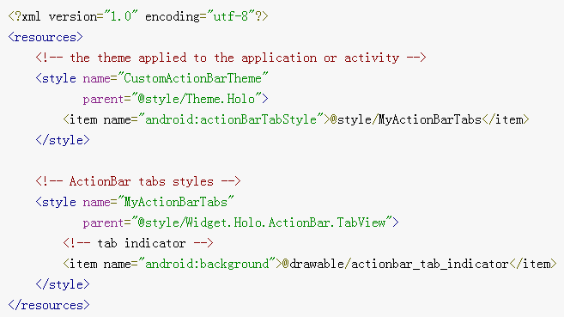
res/values/themes.xml

Slide 30

Overlaying the Action Bar
To avoid resizing your layout when the action bar hides and shows, you can enable overlay mode for the action bar.

Slide 31
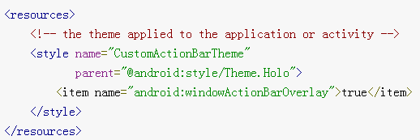
Enable Overlay Mode
To enable overlay mode for the action bar, you need to create a custom theme that extends an existing action bar theme and set the android:windowActionBarOverlay property to true.

Slide 32
Specify Layout Top-margin
When the action bar is in overlay mode, it might obscure some of your layout that should remain visible.
To ensure that such items remain below the action bar at all times, add either margin or padding to the top of the view(s) using the height specified by actionBarSize.

Slide 33
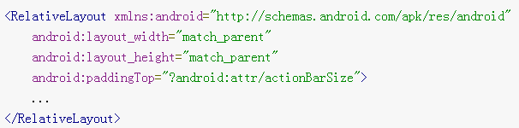
For example:

Slide 34
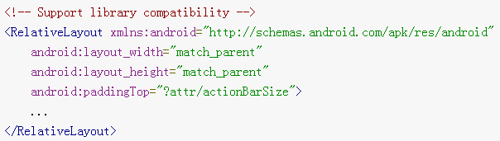
If you're using the Support Library for the action bar, you need to remove the android: prefix.
For example:
In this case, the @attr/actionBarSize value without the prefix works on all versions

